Slide 1
Figure Outline

Slide 2
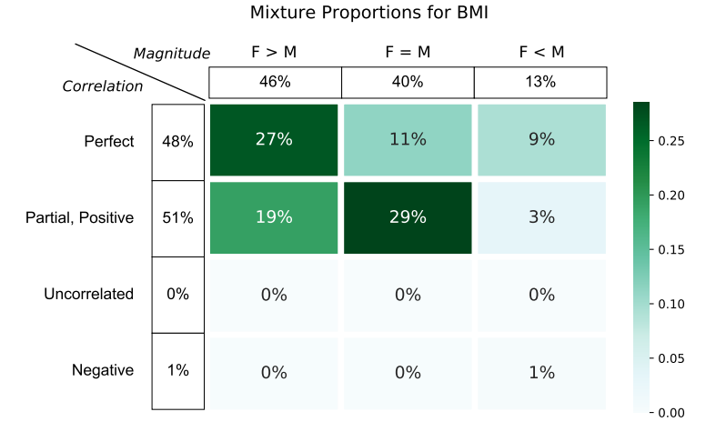
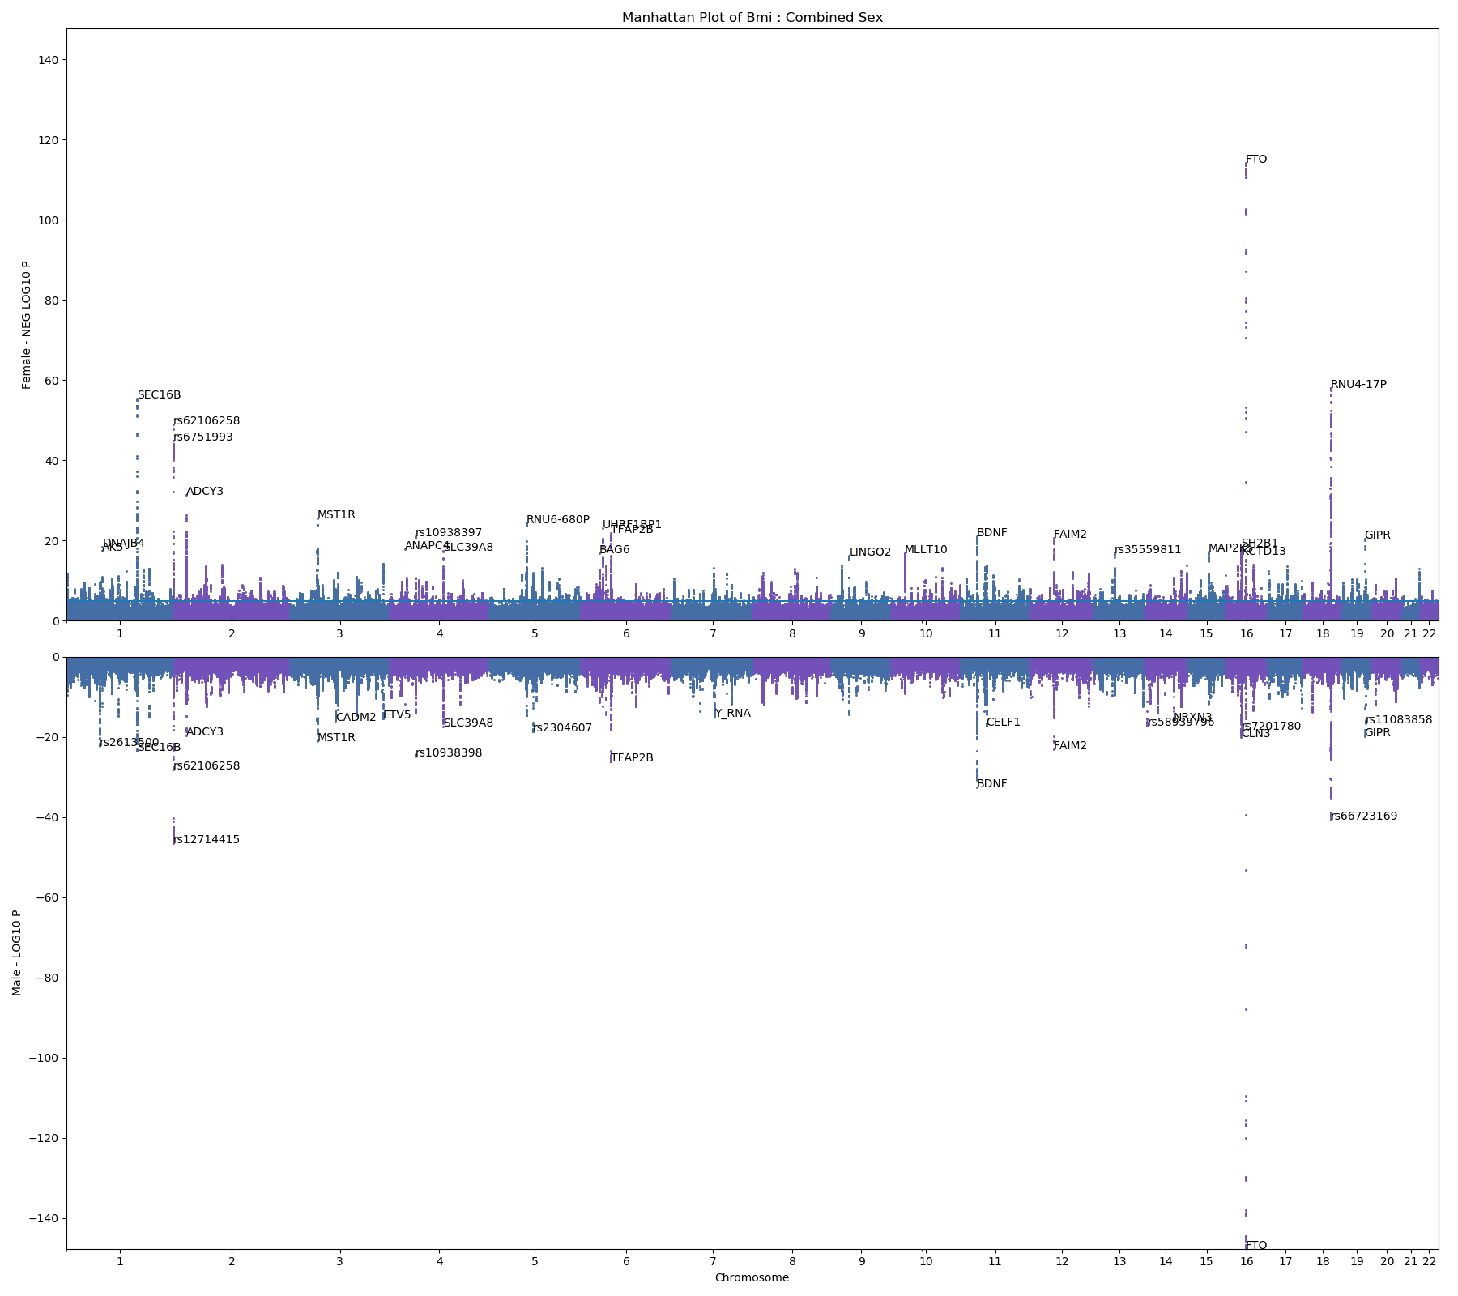
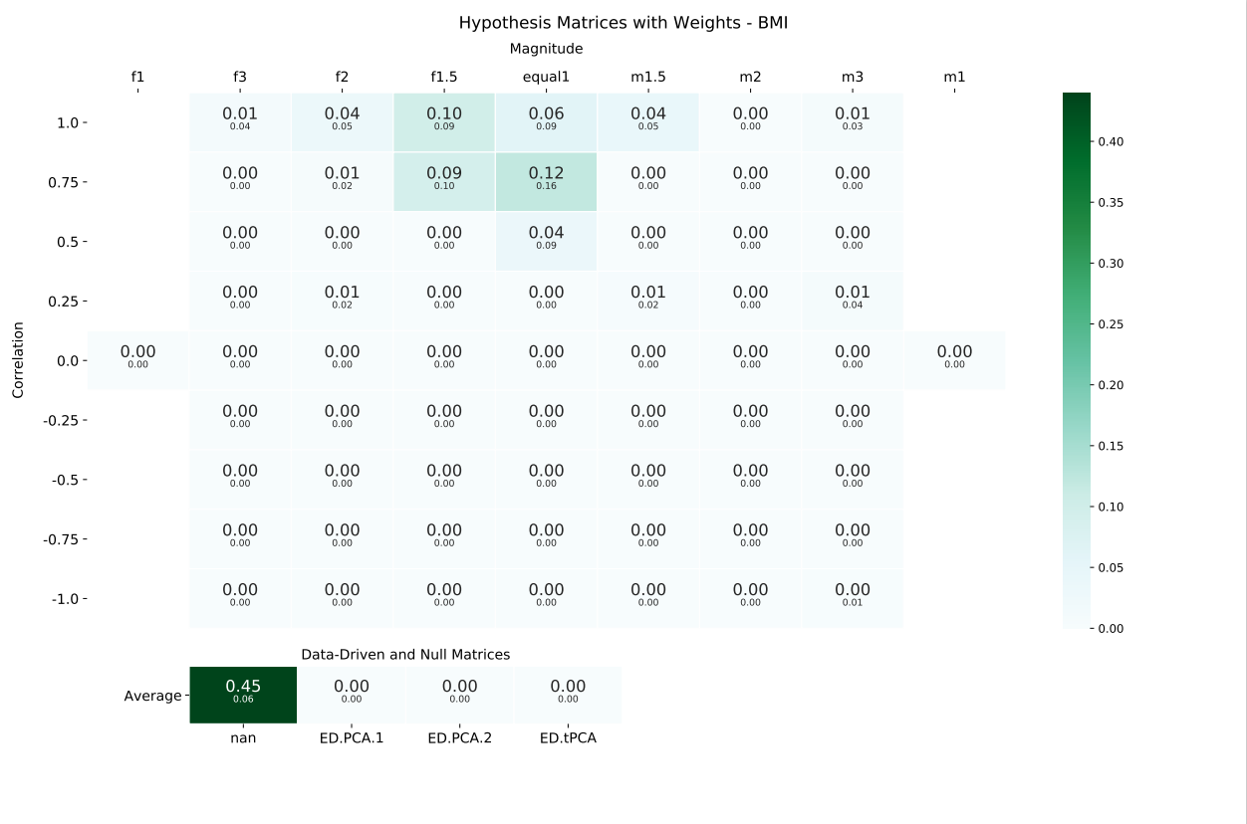
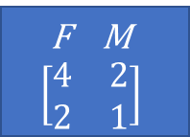
FIG 1
Model polygenic covariance between males and females
F M
$$\left[\begin{matrix}4 & 2 \\ 2 & 1\end{matrix}\right]$$

Slide 3
FIG 2
1
0
Trait1
Trait2
Correlation
Trait3
Trait4
Relative Heritability

Slide 4
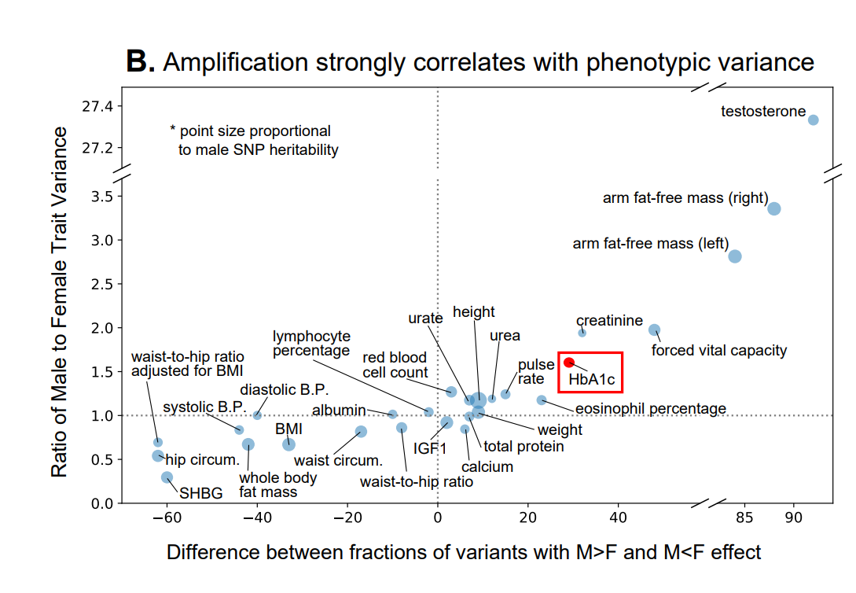
FIG 3

Slide 5
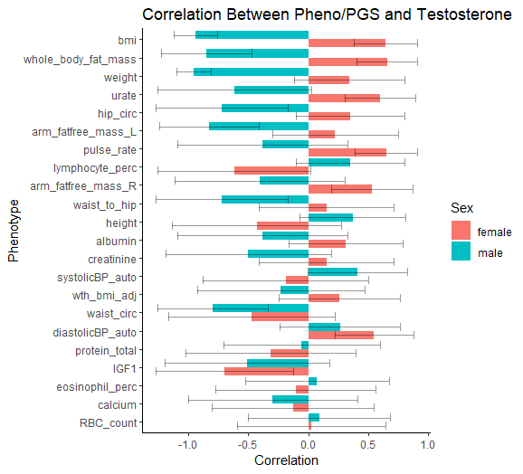
FIG 4

Slide 6
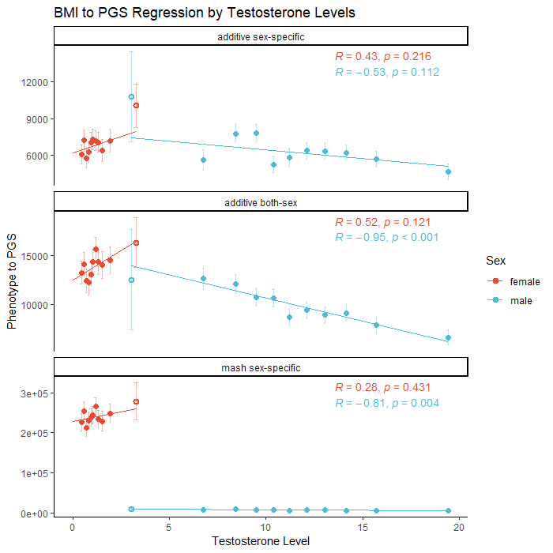
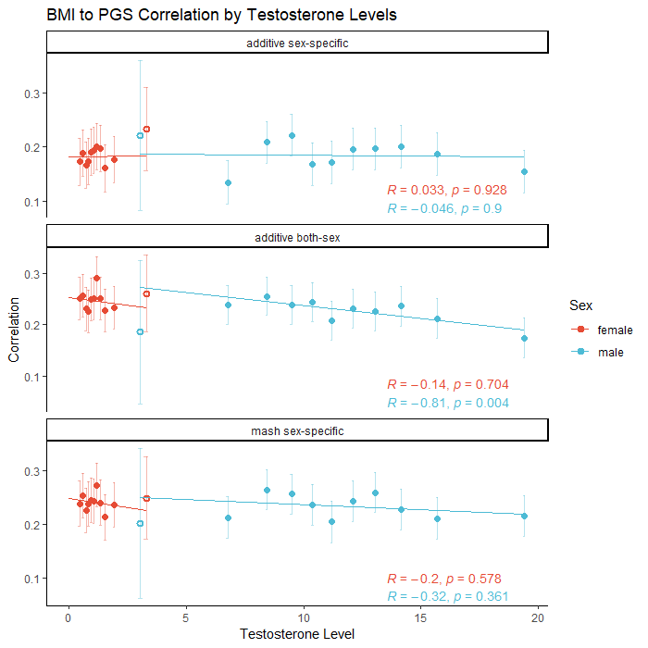
FIG 5

Slide 7
FIG 6

